Slide 1


Dr. D. Y. Patil Institute of Technology , Pimpri
Presented by (Group No. 14)
Mr.Shashank Sameer Joshi (Roll No. BMHC03)
Mr. Dineshkumar Dhanappa Vhankade (Roll No.BMHC04)
Miss. Sneha Vitthal Koli (Roll No. BMHC07)
Miss. Kirtee Pralhad Dubal (Roll No.BMHC11)
Under the Guidance of
Dr. Sumit Desai
Project Topic :Design and development of XY axis sketching robot
(Sponsored by i-Tech Robotics & Automation Pvt. Ltd.)

Slide 2
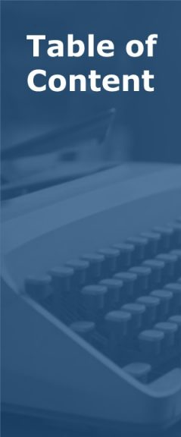
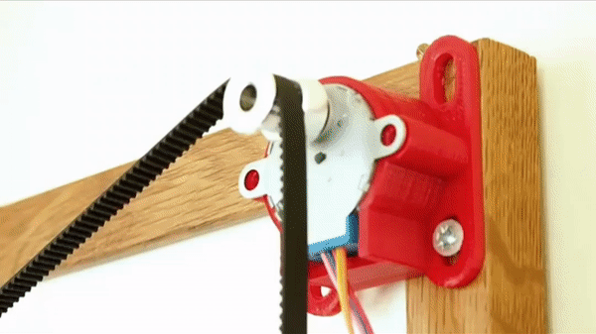
1
INTRODUCTION
2
LITERATURE REVIEW
3
PROBLEM STATEMENT
4
OBJECTIVES
5
POSSIBLE OUTCOMES
6
REFEERENCES

Slide 3
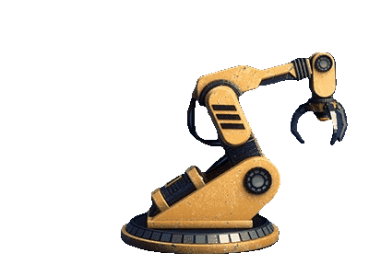
INTRODUCTION OF ROBOT
What is Robot?
A robot is a type of automated machine that can execute specific tasks with little or no human intervention and with speed and precision.
Robots are repeatable precision at al times, can perform multiple tasks simultaneously.
Nowadays are being extensively used in the field of Industry, education and entertainment.
X-Y Axis Robot
Robot operates in two axes of motion ("X" and "Y") in order to perform task of drawing & writing like human.

Slide 4
LITERATURE REVIEW
Sr.No. | Name of Author/s | Title of the Paper | Name of the Journal (Vol. No. Year) | Relevant Findings | Literature Gap
01 | 1)Sidharth Tripathi 2)Dev Joshi 3)Beauty sharma | XY Plotter | Volume-6, issue-4,Oct-2018 | For efficient work of robot they used polargraph server Arduino based program and polar gharph processing software. | We can use this robot for cutting, engraving. By replacing pen with tool.
02 | 1)Mrs.R.Dayna 2)Gunaseelan P | Microcontroller based X-Y plotter | Volume.3, issue 3,Apr 2014 | 1)low power consumable microcontroller (MSP430) is used. Which consume 3.5v input 2)For better accuracy draper motor is uesd. | We can convert this mechanism in to 3 axis movement.

Slide 5
LITERATURE REVIEW
Sr.No. | Name of Author/s | Title of the Paper | Name of the Journal (Vol. No. Year) | Relevant Findings | Literature Gap
03 | 1)Saurabh Sharma 2)Harish 3)S.B Nikam | X Y drawing robot using Arduino | Volume6 issue 2, | To raise and lower the pen spring is used. And stepper motor is used for moving pen. | We can modify this system by using scalar vector graphics ,(SVG)
04 | 1.Rowjatul Zannat Eshita 2.Tanwy Barua 3.Arzon Barua 4.Anik Mahamood Dip | Bluetooth Based Android Controlled Robot | Volume-5, Issue-3, pp-195-199 | To designing a Robot that can be operated using Android Apps using Bluetooth sensor | A Robot can Mount with camera

Slide 6

LITERATURE REVIEW
Sr.No. | Name of Author/s | Title of the Paper | Name of the Journal (Vol. No. Year) | Relevant Findings | Literature Gap
05 | 1.Kaustubh Gawli 2.Parinay Karande 3.Pravin Belos 4.Tushar Bhadirke 5.Akansha Bhargava | INTERNET OF THINGS (IOT) BASED ROBOTIC ARM | Volume: 04 Issue: 03 | Mar -2017 | They controlled robotic arm with of using IOT sensor which integrate mobile and pc | We can make robot which can receive image through using IOT

Slide 7
01
can draw any sketch of various sizes.
Problem statement :
02
Functioning/Execution of the
program as per requirement.
Design & Develop a Robot
Can perform its function
with less errors
03
Easy to operate with
less input requirements
04
Can be fitted in less time
& easy to install.
05
06
To make it portable, can be
operate from anywhere

Slide 8
Objective
Objective 2
Objective 1
To create a model based on design
To design a robot which can draw any sketch based on i/p
Objective 3
To make a assembly of sketch robot
Objective 4
objective
To Execute and analysis the result and make a record

Slide 9
POSSIBLE OUTCOMES
Robot for drawing any sketch with any size
portable robot which operate from any where.
Multi purpose robot.
Should be easy to used

Slide 10

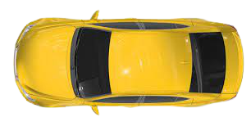

Technical flow chart
PNG→SVG
Processing → G-Codes
Arduino → Electric Signal
E-Signal → Mechanical O/p
Result→ Drawing

Slide 11
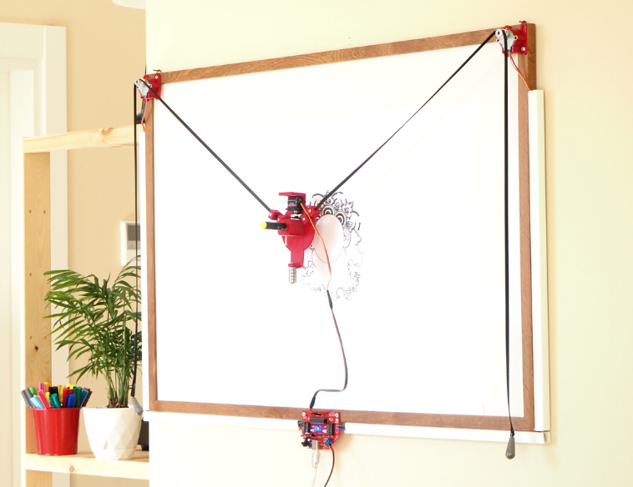
Actual project photo-Reference

Slide 12
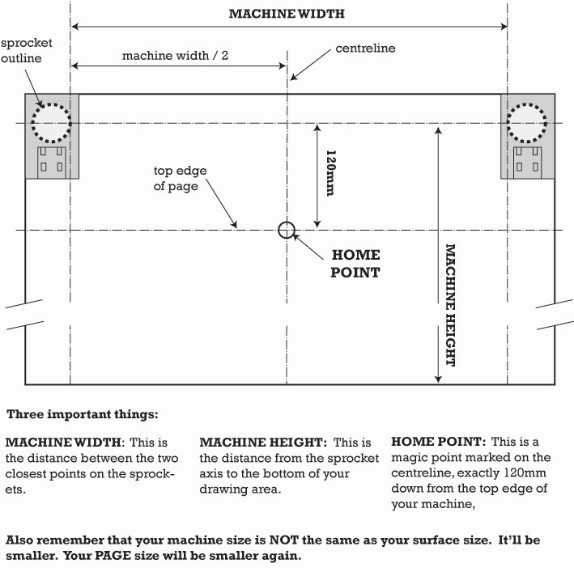

Slide 13
FLOWCHART
1
Study of basics of robotics & planning for Industrial visit
2
3
Prepration of Bill Of maetrial for required parts.
Prepare 3D models for support brackets & Pen holder.
4
Understanding the various software's like 3D Printing software (Ultimaker cura), programming software.
5
Receipt of materials along with hardwares
6
Building prototype for trial purpose, final assembly on board
Check for source codes & machine settings, uploading image for testing working of robot.
7

Slide 14
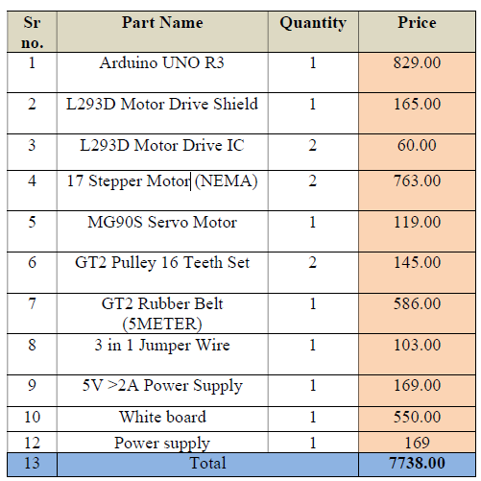
Bill of material

Slide 15
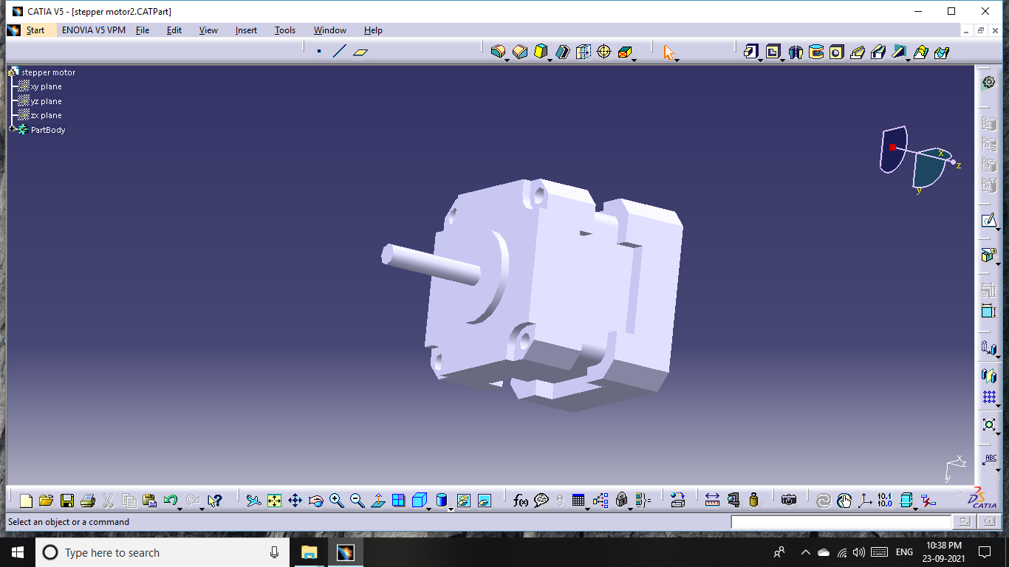
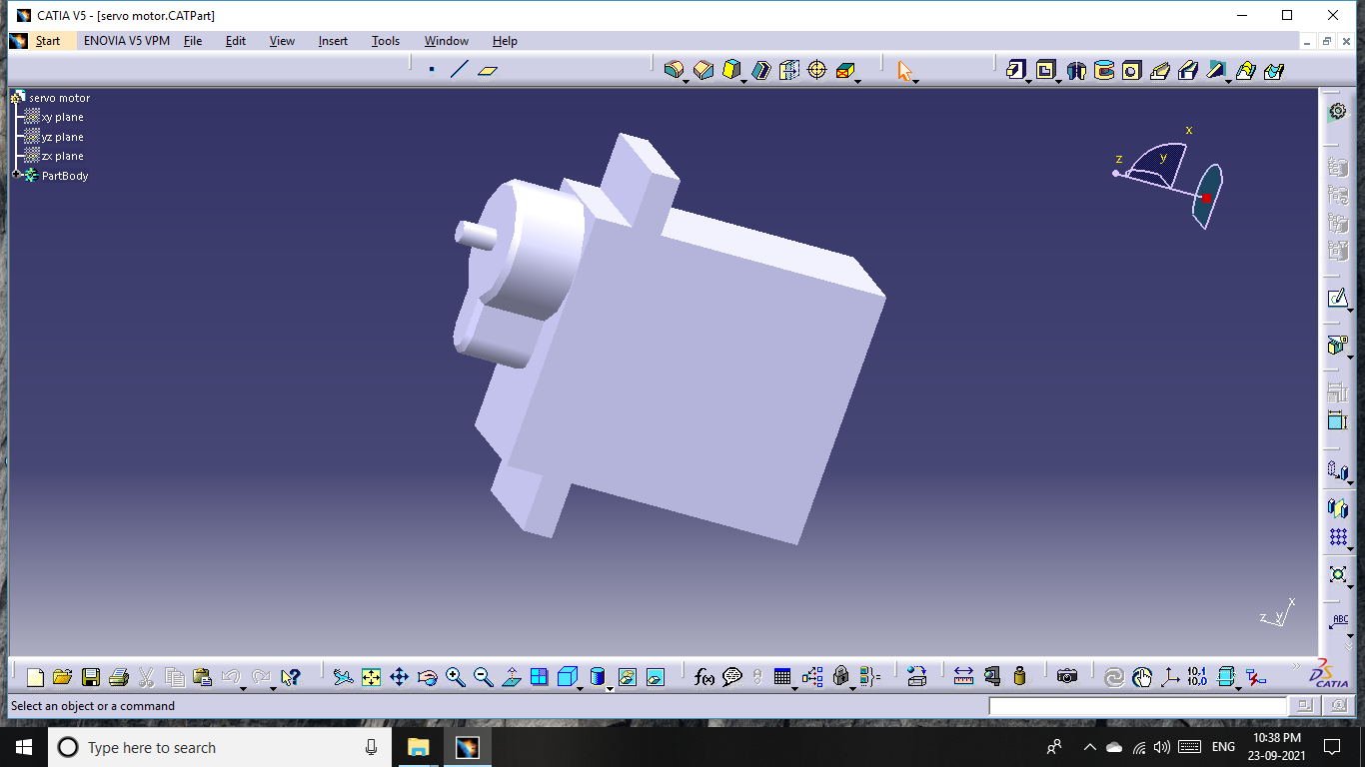
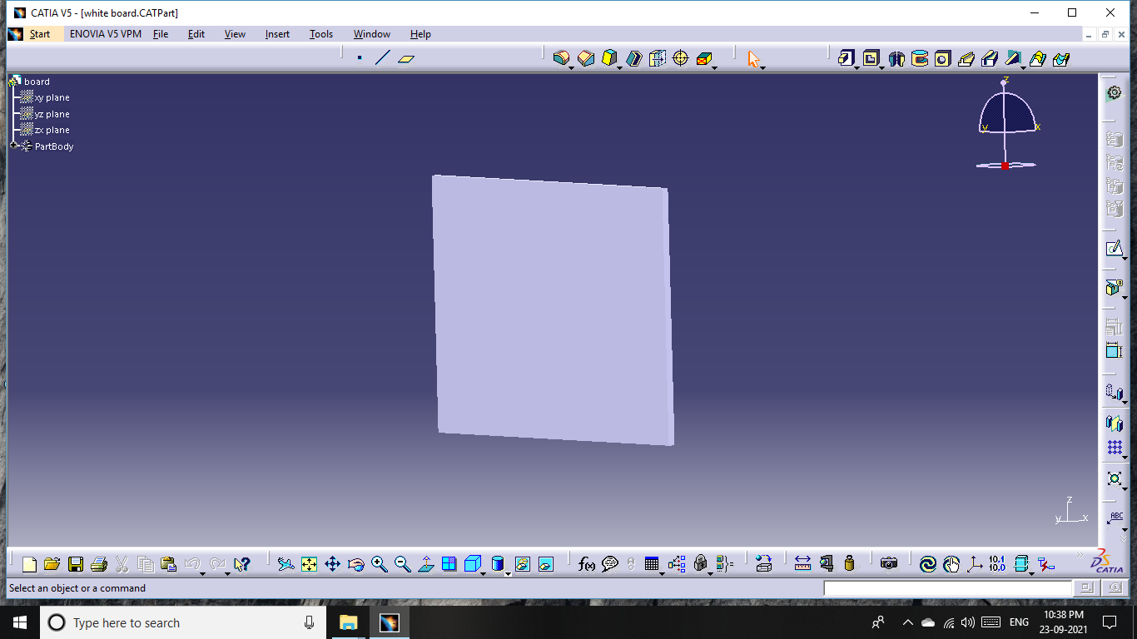
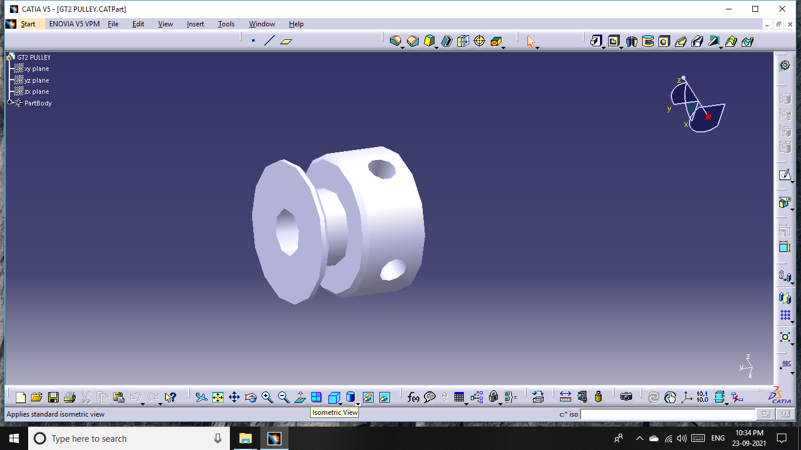
Preparation of 3D Model of all parts
STANDERD SIZE
STANDERD SIZE
SIZE:-5 MM
16 TEETH
SIZE:-2*3 feet

Slide 16
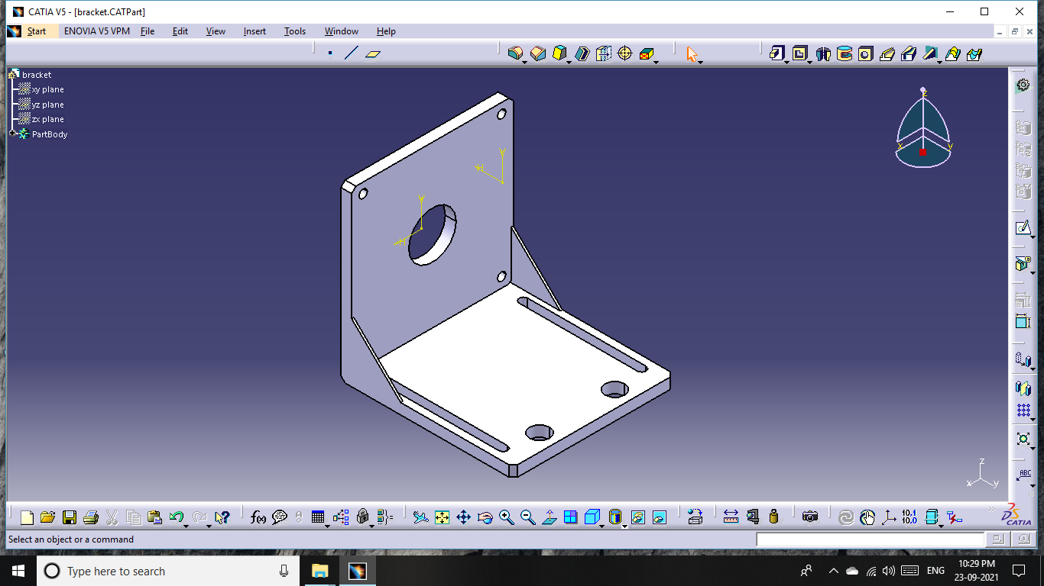
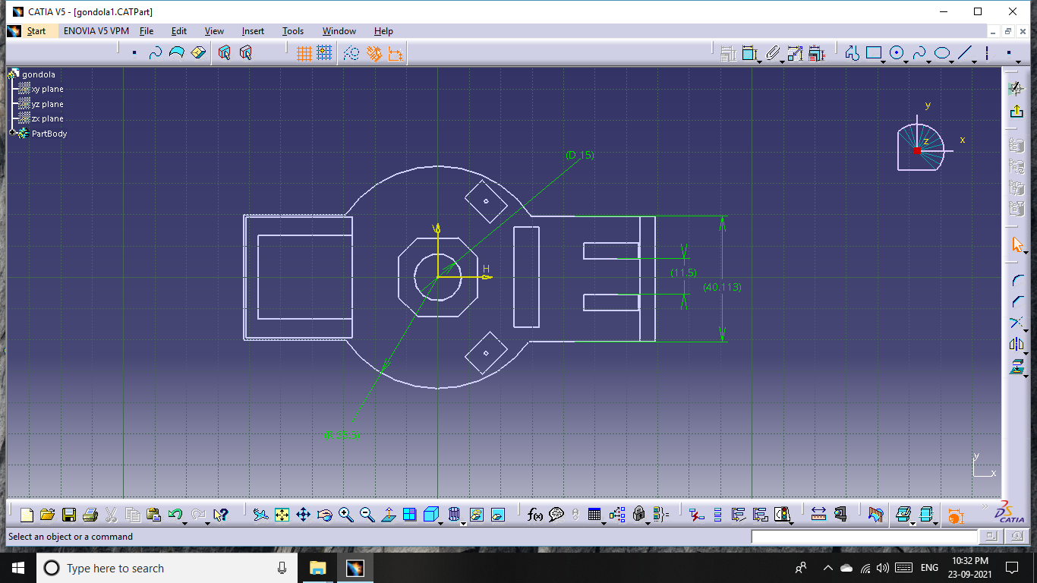
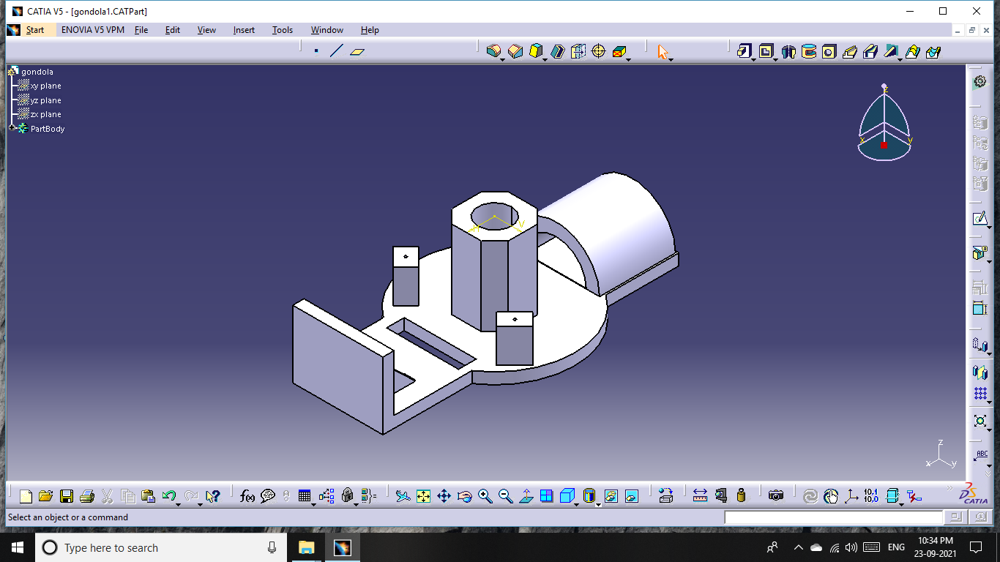
Preparation of 3D Model of all parts
Part – motor bracket
Standard size
Part- Pen holder
Part – Pen Holder

Slide 17
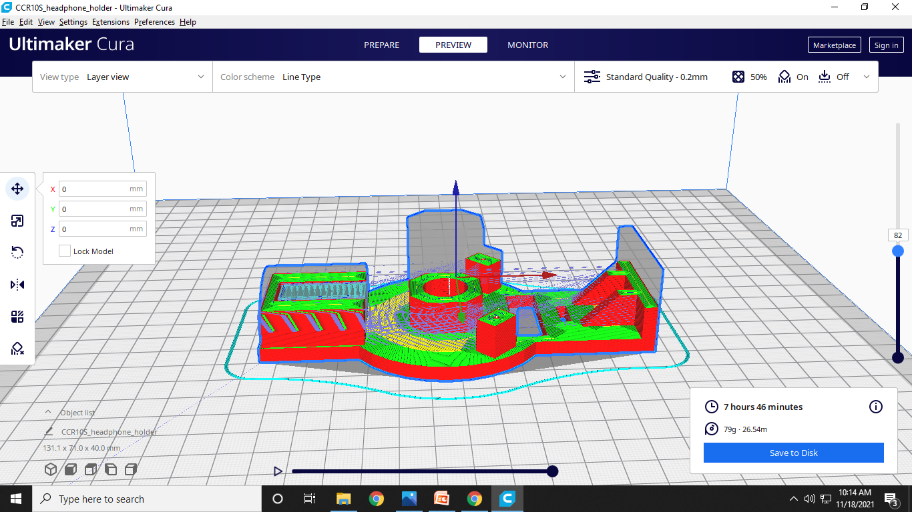
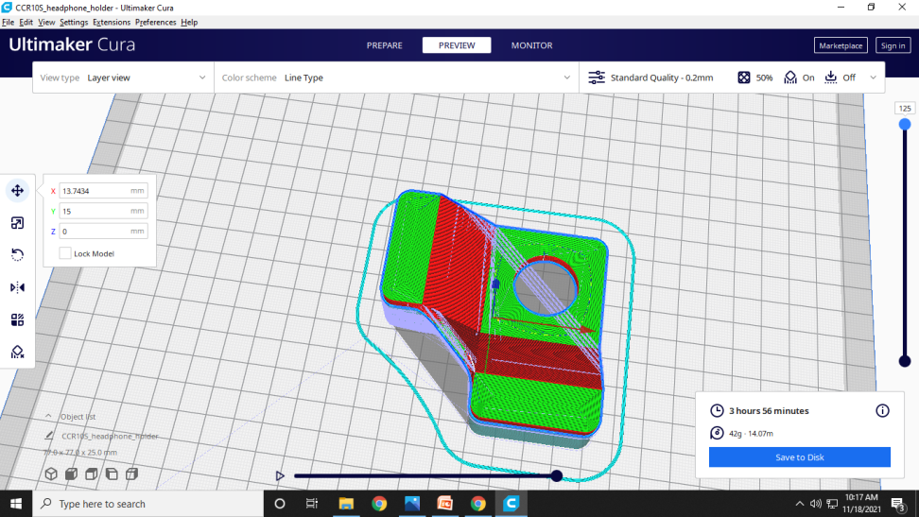
3D Printing parts preparation using software : Ultimaker Cura

Slide 18
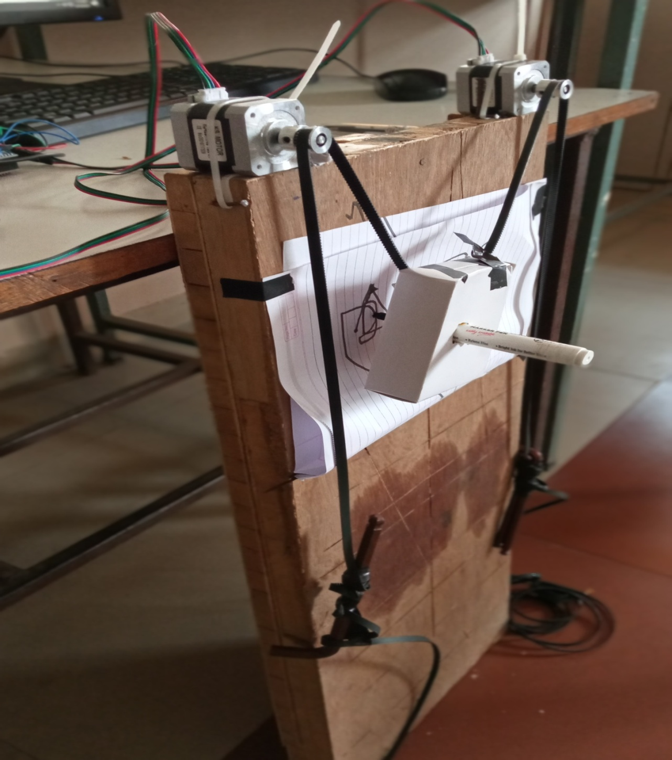
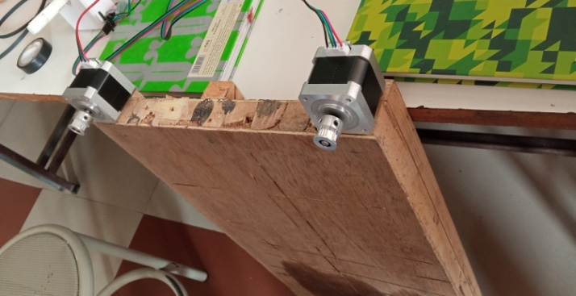
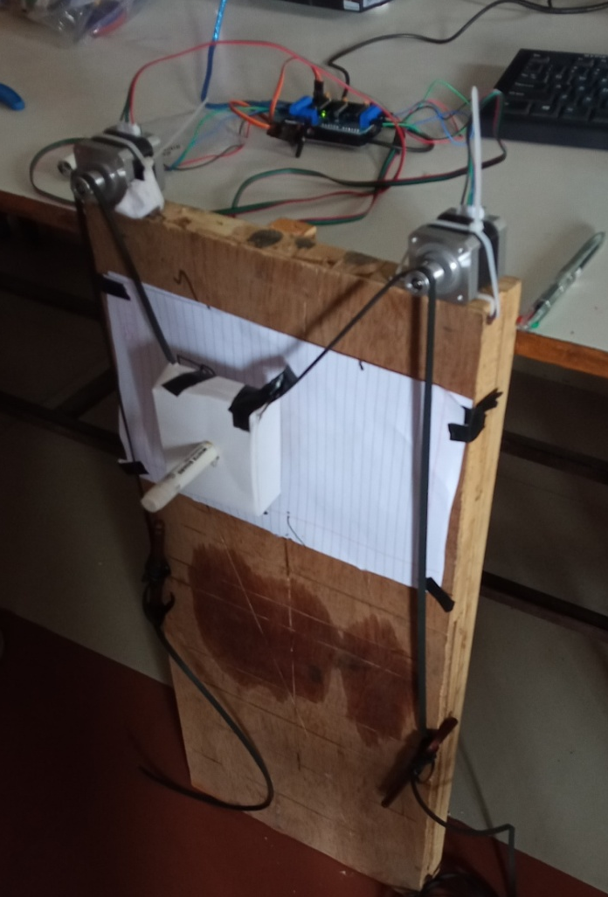
Prototype of project

Slide 19
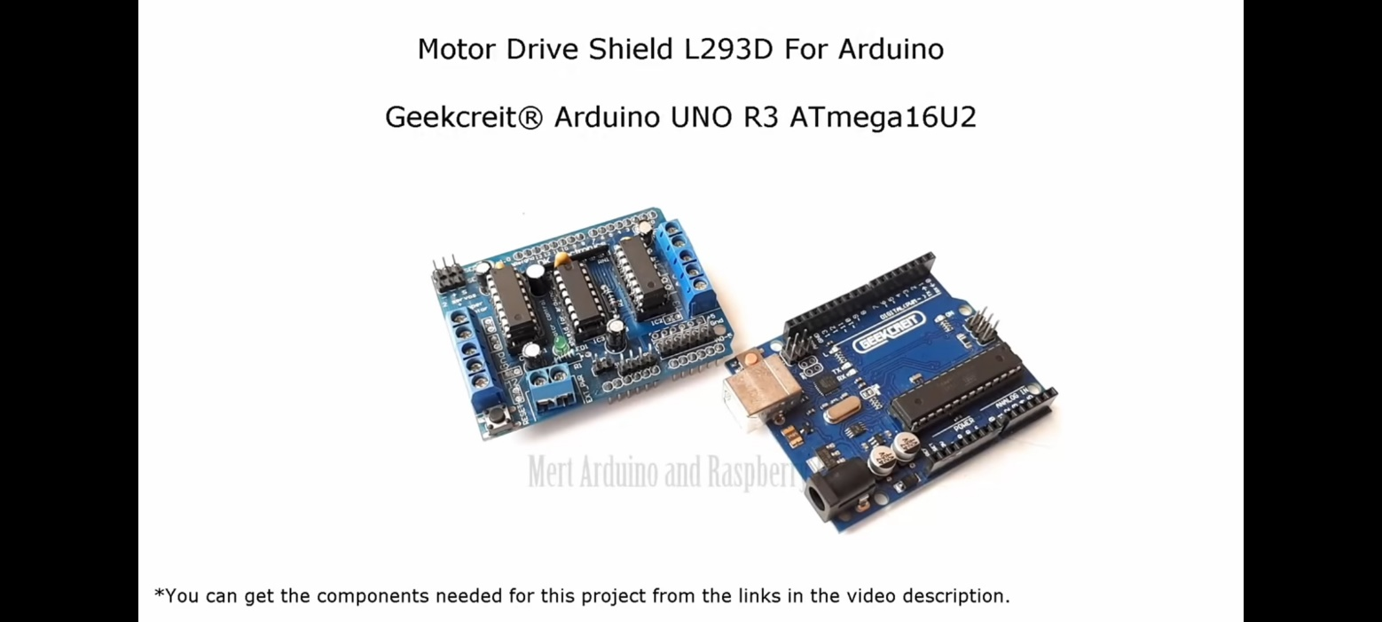
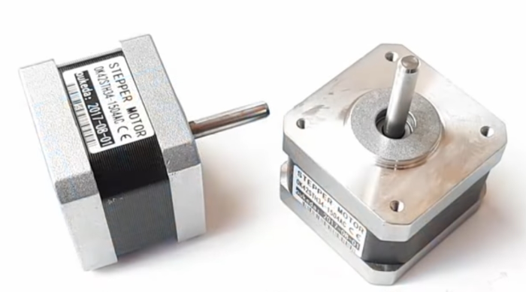
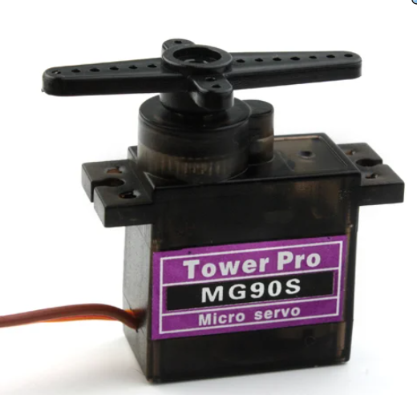
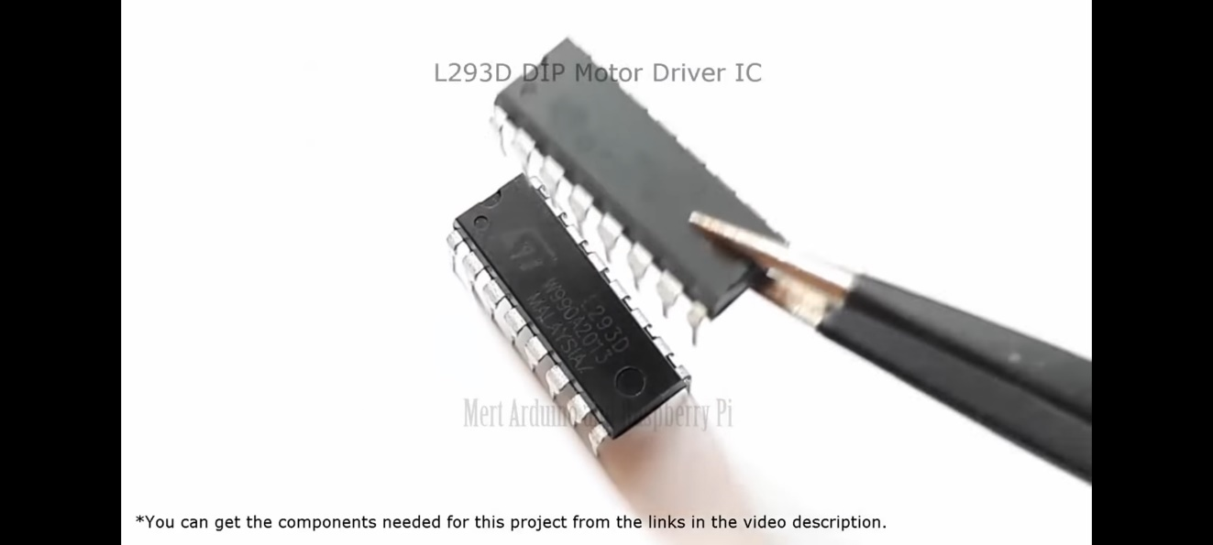
All components
Arduino Board UNOR3 Quantity 1 | Nema 17 stepper motor Quantity 2
Servo motor MG90S Quantity 1 | Motor Driver IC L293D Quantity 2

Slide 20
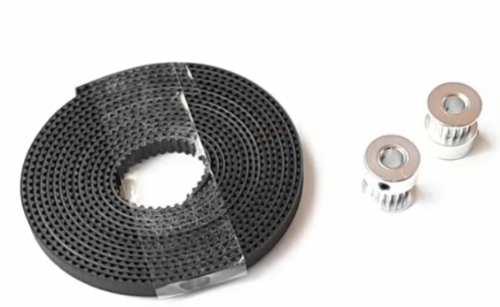
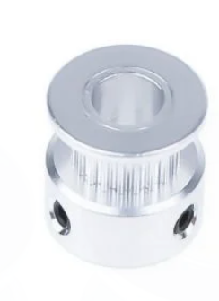
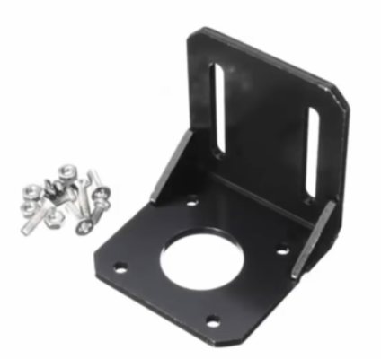
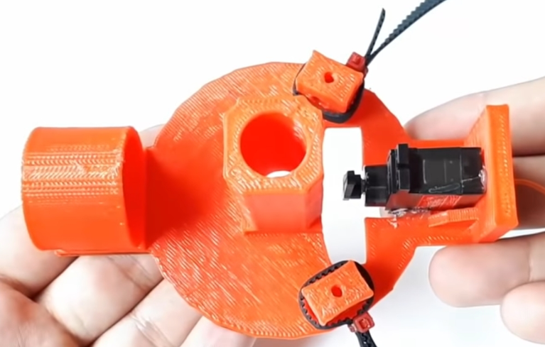
All Components
GT2 Rubber Belt Quantity 1 | GT2 16 teeth Pulley Quantity2
Mounting bracket Quantity2 | Pen Holder Quantity1

Slide 21
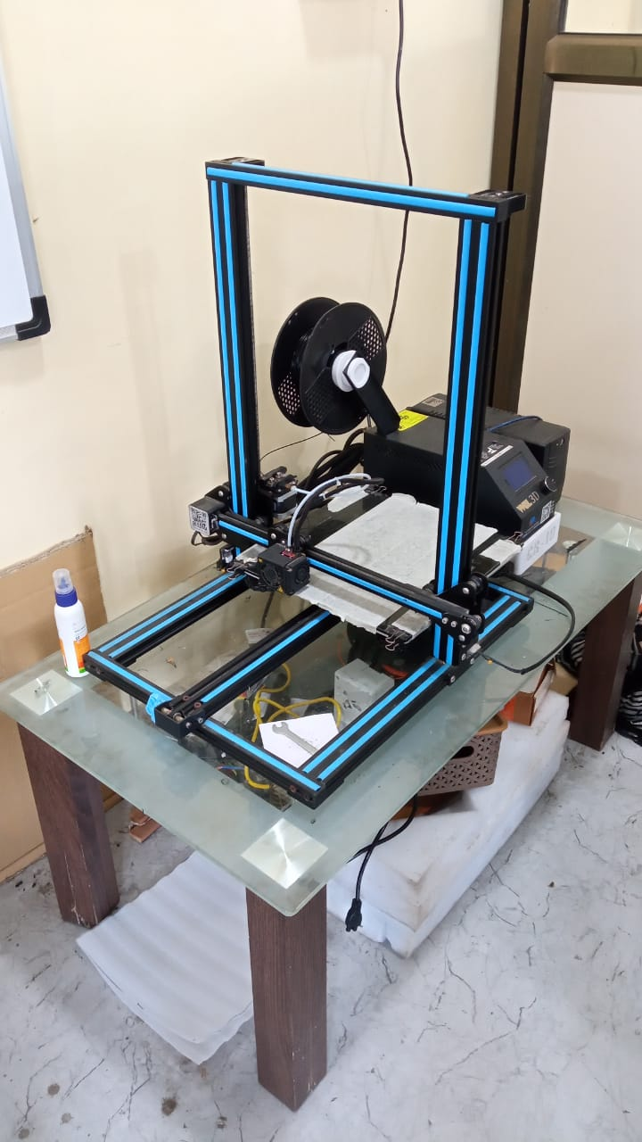
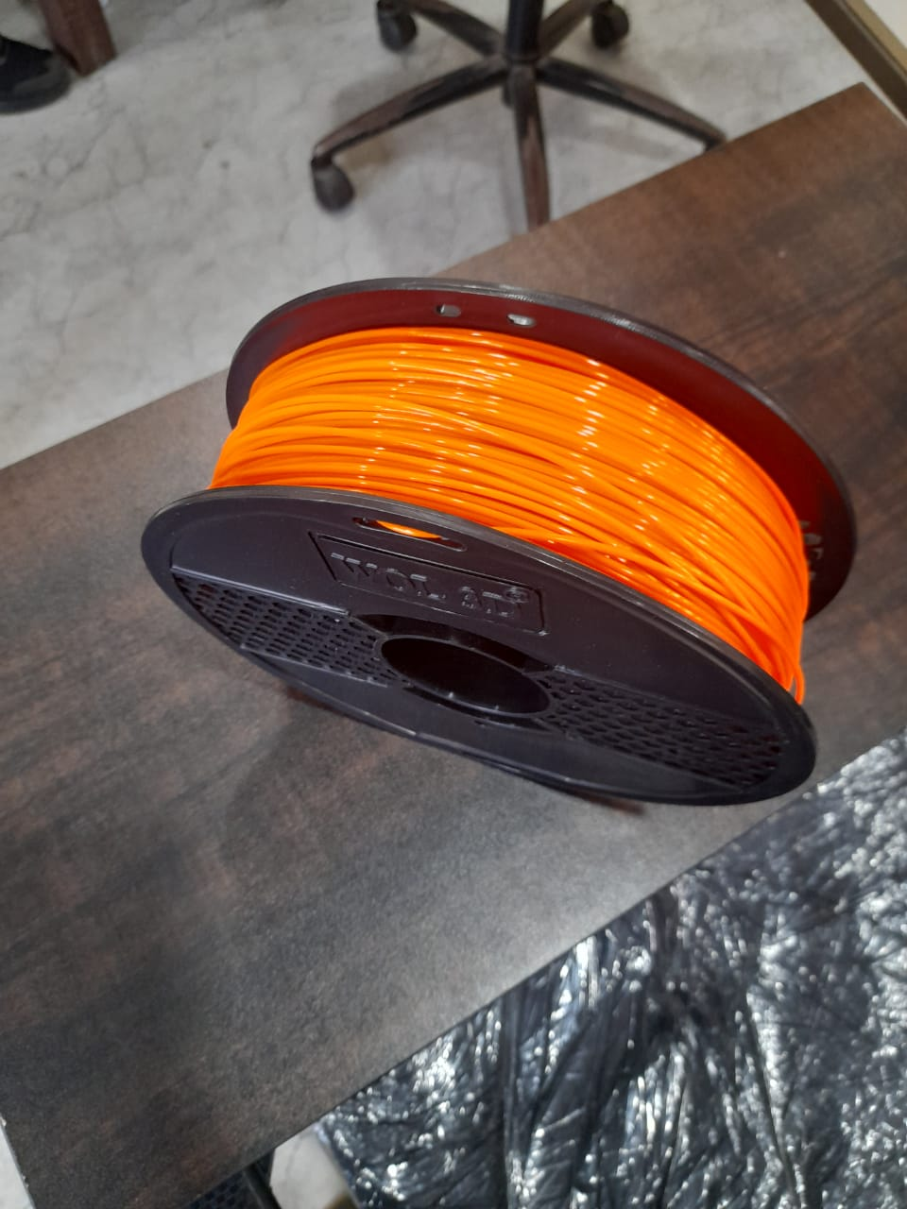
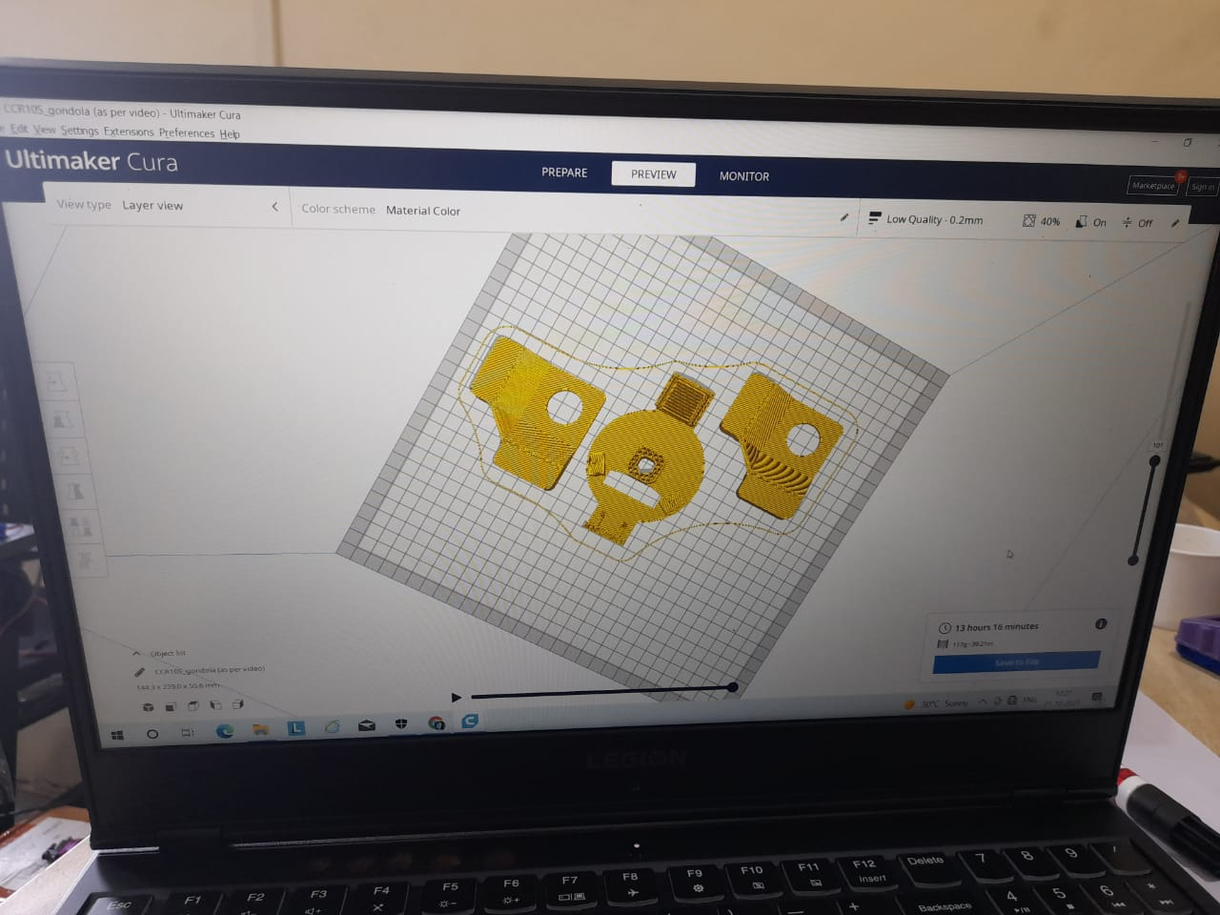
MATERIAL USED PLA+
CARTISIAN ROBOT TYPE OF 3D PRINTER

Slide 22
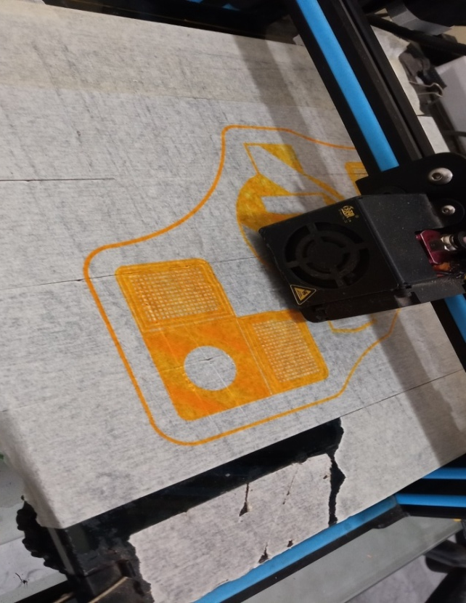
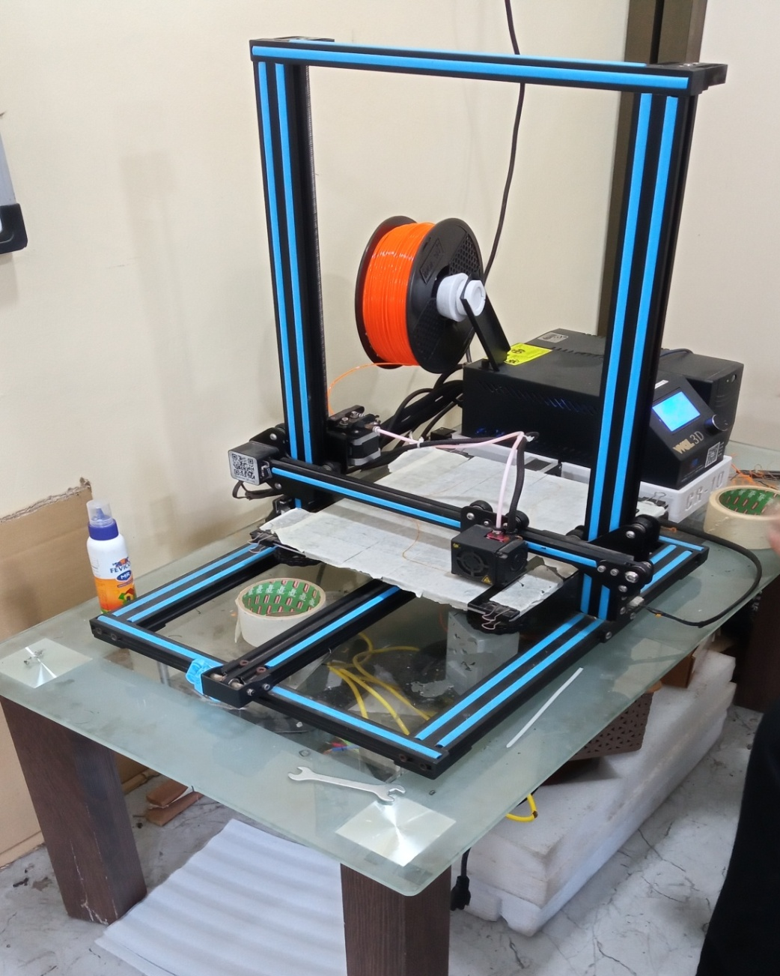
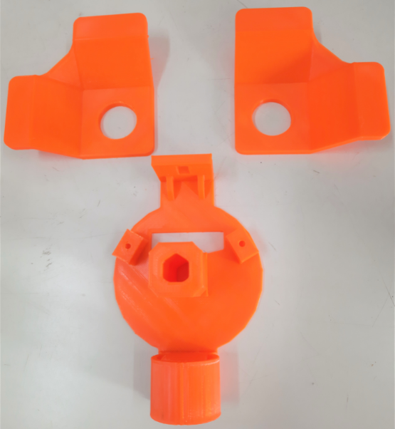
3D Printing Process

Slide 23
3D Printed pen holder & support bracket

Slide 24

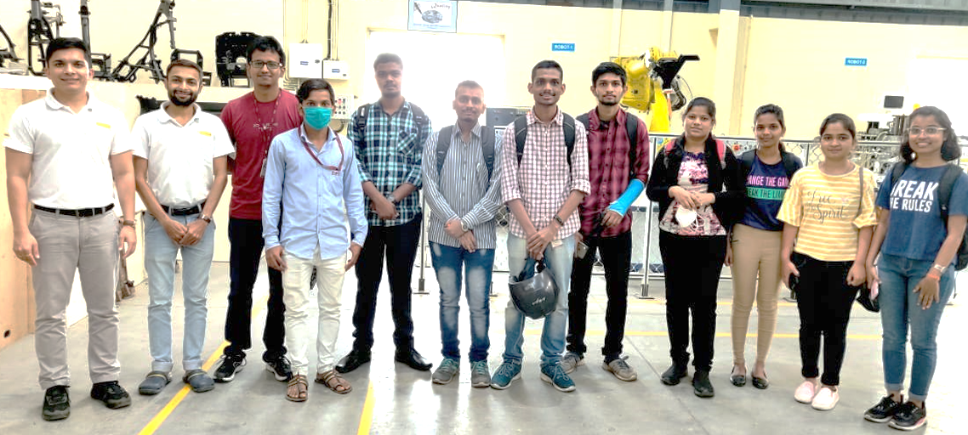
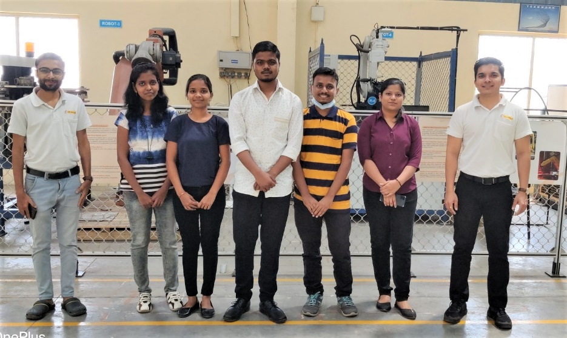
Visit to Industry
1st Visit DATE
Types of robot
Hands-on Experience on robot
Robot application
Parts of robot
Feature scope
2nd Visit
Basic of 3d printer
Hands-on on 3d printer
Procedure to give command to printer

Slide 25

References
XY Plotter, Volume-6, issue-4,Oct-2018
Micro troller based X-Y plotter, Volume.3, issue 3,Apr 2014
X Y drawing robot using Arduino, Volume6 issue 2,
Design, Implementation & analysis pf Low cost robot for educational purpose, International Journal of Pure & applied Mathematics, Vol. 118 No.16 2018, 213-230
Textbooks : Appu Kuttan K.K. , Robotics, I. K. International Publisher, Banglore,Delhi.

Slide 26


